Slide 1
www.day-of-photonics.org Photonic technologies are very important and everywhere!

Slide 2
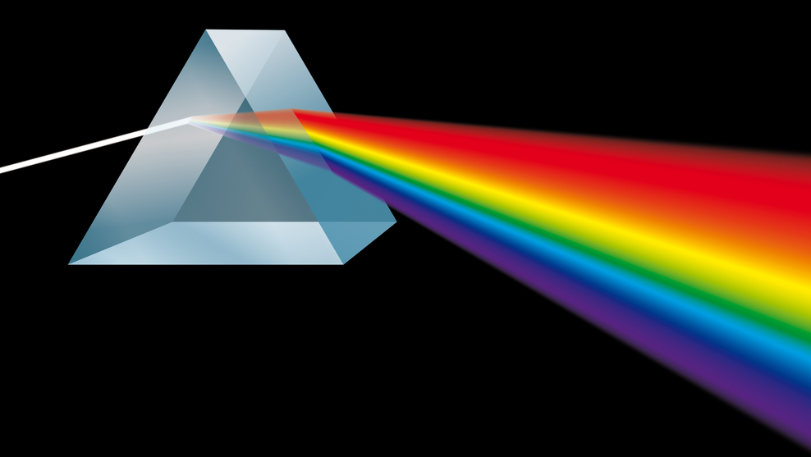
Photon originates from the greek language, phōt = light
Lasers
Lenses
Mirrors
Optics
Fibers
Photonics involves the creation, use,
and modification of light.

Slide 4
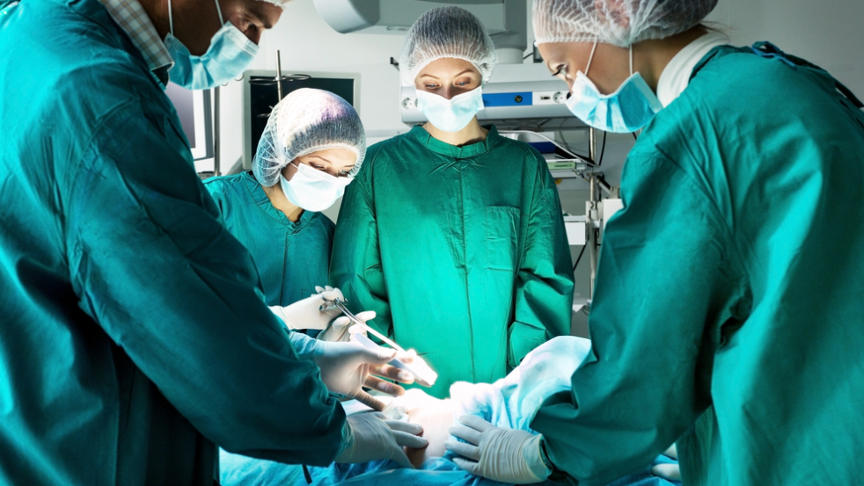
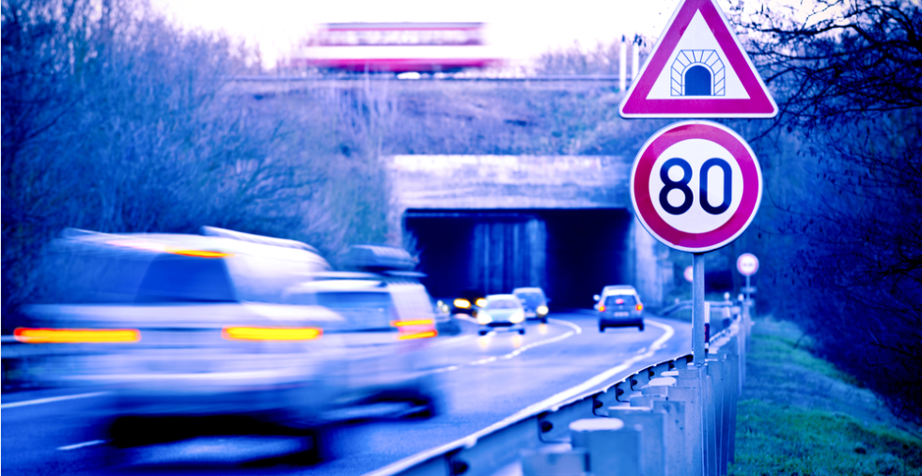
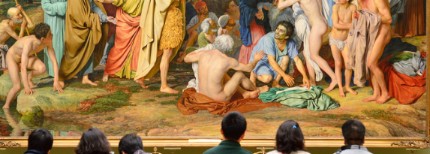
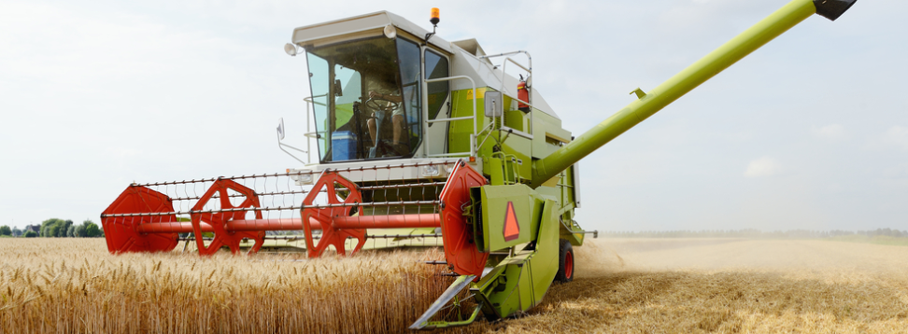
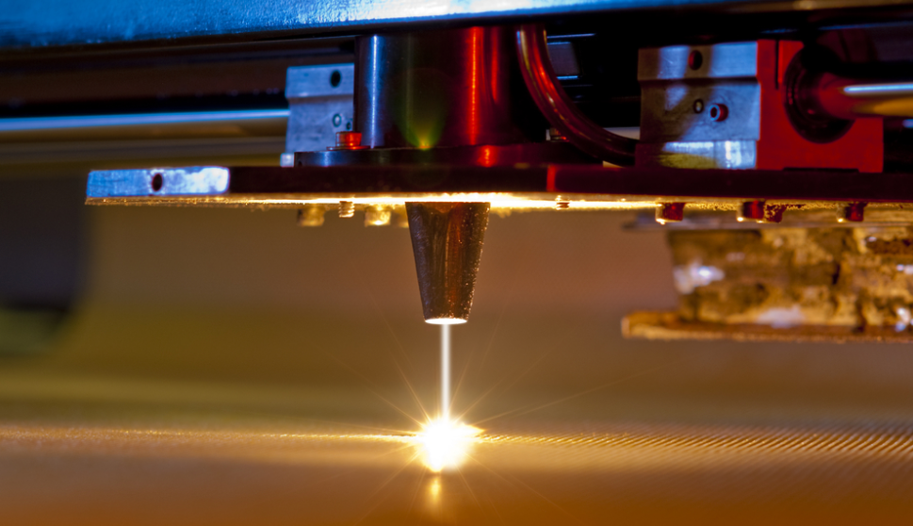
Some examples of applications …

Slide 5
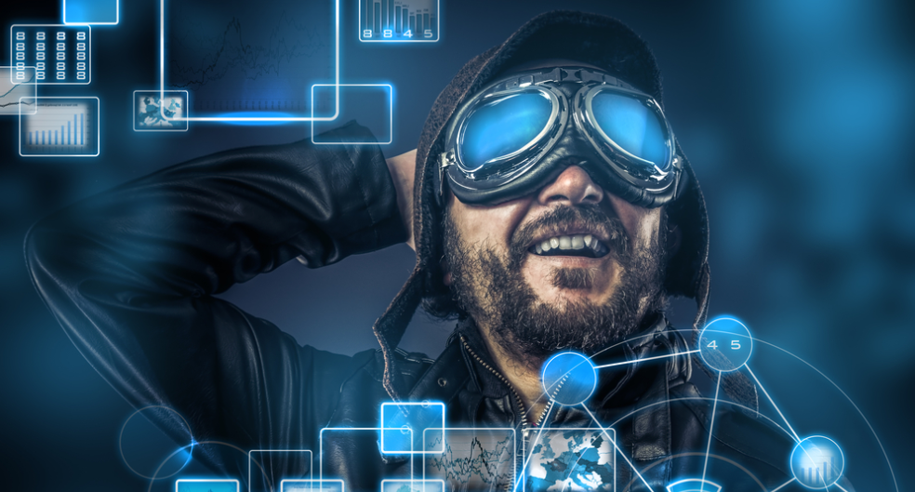
Communication
Display and miniature projectors (GPS, television, cinema), cameras
Telecommunication (internet) optical fiber communications
Did you know: Light travels 10 times the speed that electricity does, internet data transmitted photonically can travel long distances in a fraction of the time.

Slide 6
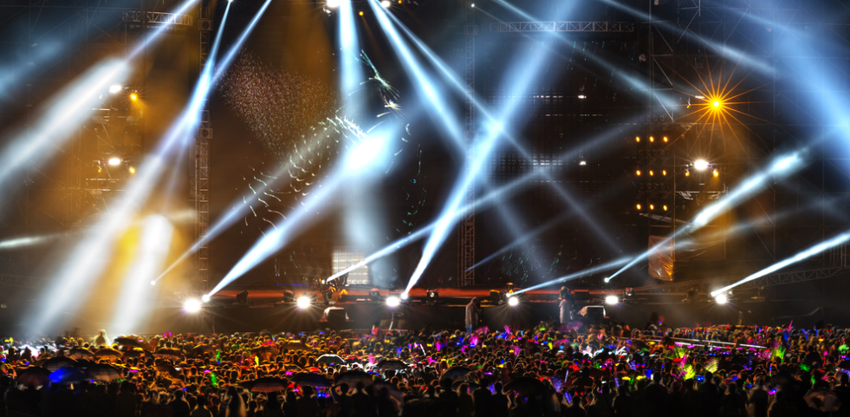
Entertainment
Light shows in parties and monuments decorative lighting
Consumer electronics, displays in smart phone, CD and DVD
Did you know: Thin and flexible displays could be incorporated into your magazine!

Slide 7
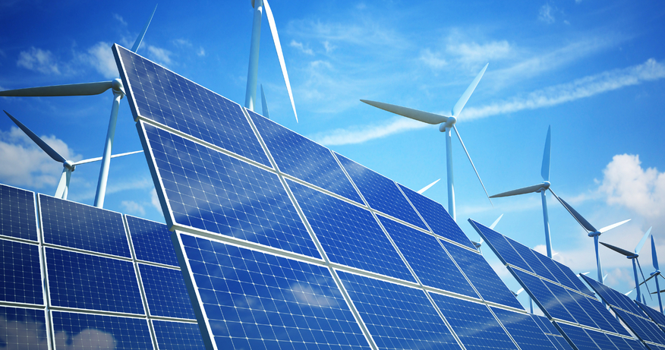
Energy
Photovoltaic solar panels transform light into electricity and provides power in remote areas
Fibers are used for sensing in the oil & gas industry
Energy efficient lighting (LED)
Did you know: You can shoot a laser beam to a solar cell on a flying drone to recharge it!

Slide 8
Transport (cars, trains, planes)
Manufacturing includes laser systems used in welding, cutting, marking
Sensors, heads-up display, lighting
Did you know: Laser head-light on a car can reach as far as 600 meters!

Slide 9
Health
Analysis of bacteria and life-science applications
Imaging of cancerous tumour cells
Laser eye surgery, tattoo removal, endoscopy, health monitoring
Did you know: Sensors can analyze sugar levels in the blood through the skin!

Slide 10
Manufacturing
Lasers can cut, weld, and mark many materials such as plastic, textile, metal
3D printing involves lasers
Cameras are used for machine vision inspection
Did you know: A high-power laser is capable of cutting through 8 centimeters of steel!

Slide 11
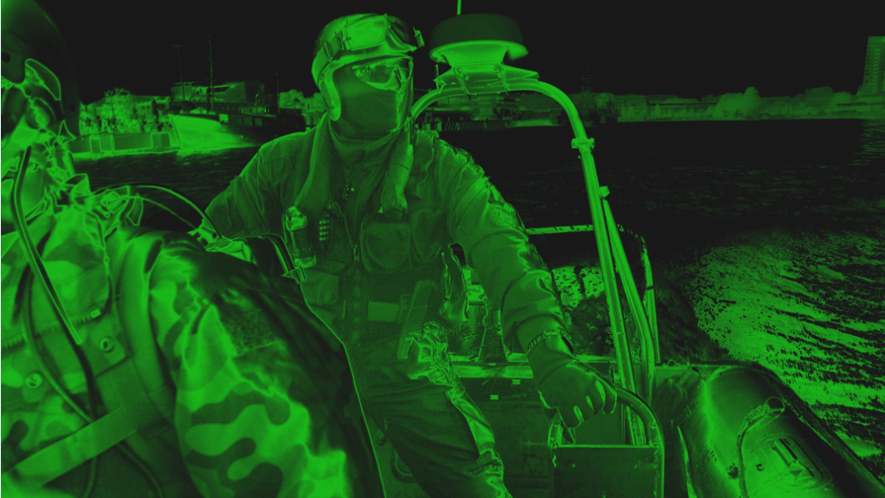
Security, defense, rescue
Night vision devices, mine laying and detection, photonic gyroscopes, chemical detection
Textiles with displays for firemen and carpets in hotels in case of fire
Did you know: It is possible to identify at a distance if a driver has been drinking alcohol !

Slide 12
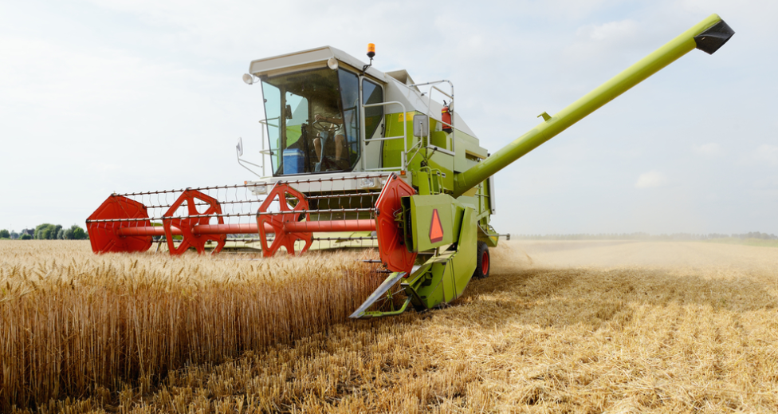
Agriculture
Soil analysis, crop analysis
In-door farming, controling vegetable speed growth and influence raspberry taste with light
Did you know: Drones mounted with a camera can analyse the soil for precision agriculture!

Slide 13
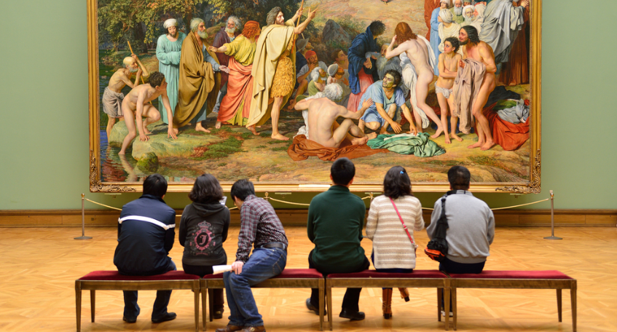
Arts
Laser imaging techniques are used for the detection of forgeries
LED technology reduces UV and IR, is more energy efficient, and improves colour rendering
Did you know: The Sistine Chapel uses latest LED illumination systems developed for art.

