Slide 1

Light Up Your Future
The Mind-Blowing World of Photonics, Lasers & Next-Generation Technology
Presented by [YOUR COMPANY NAME HERE]

Slide 2



What on Earth is Photonics?
Electricity vs. Light
Technology of the 21st Century
Electronics controls electrons (tiny charged particles) to power computers, TV screens, and appliances.
If electrons built the 20th century, photons are building the 21st century.
Photonics controls photons (particles of light) to transmit data, cut steel, sense motion, and power future tech!
It encompasses everything from smartphones and solar panels to space lasers, medical scanners, and quantum computers.

Slide 3
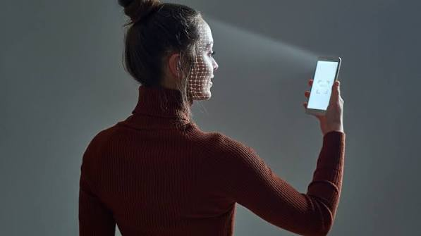

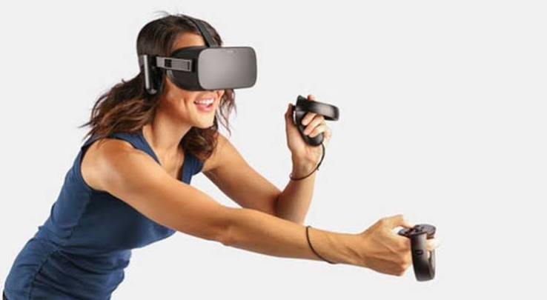






Everyday Tech You Already Use
Smartphones & Face ID
High-Speed Internet
Gaming & VR Headsets
Vibrant OLED displays, laser autofocus camera optics, and infrared dot projectors that unlock your phone with 3D facial mapping.
Streaming 4K video or gaming with ultra-low latency? Your data travels through fiber optic cables across oceans at light speed.
Micro-LED displays, eye-tracking sensors, and spatial 3D LiDAR mapping power virtual reality and next-gen gaming experiences.

Slide 4
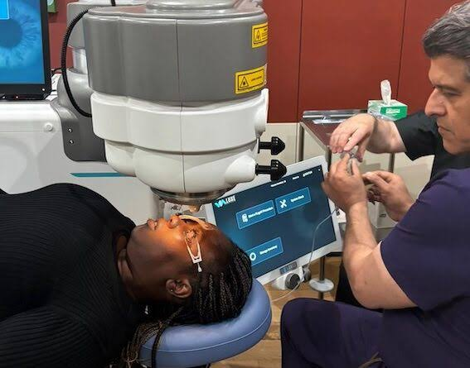
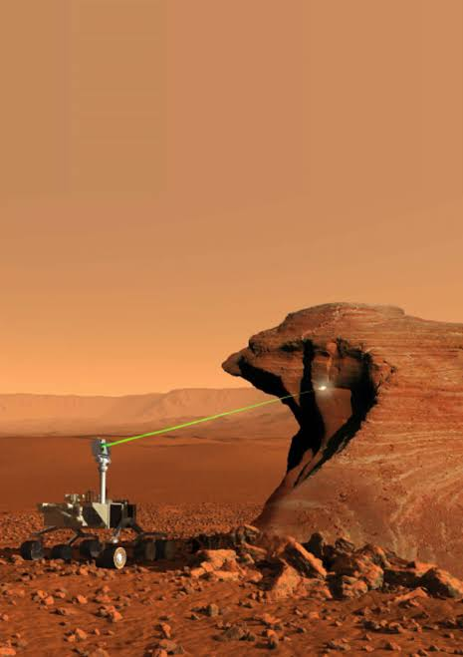

Mind-Blowing Light Applications
Saving Lives in Healthcare
Exploring Deep Space
Needle-free blood testing, ultra-precise laser eye surgery, optical biosensors detecting diseases early, and keyhole surgical tools guided by laser light.
NASA Mars Rovers use LiDAR laser scanners to navigate red planet terrain. Deep space optical lasers beam high-res HD video from space to Earth!

Slide 5
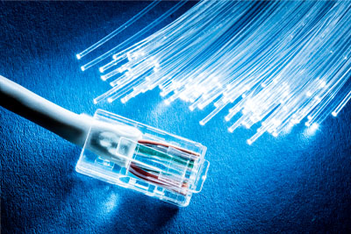
Super-Speed: Fiber Optics
Surfing the Light Beam
Instead of metal copper wires sending slow electrical pulses, fiber optic cables bounce light beams inside ultra-pure glass strands thinner than a human hair.
Because light travels at nearly 300,000 km/s, data flies across continents in fractions of a millisecond!

Slide 6


Light by the Numbers
Why October 21st?
On October 21, 1983, scientists officially fixed the exact speed of light in a vacuum to 299,792,458 m/s.
Meters per Second
Every year on October 21st, schools, universities, and companies celebrate Day of Photonics worldwide to share the power of light technology!

Slide 7
Quick Class Light Challenge!
Question | Answer
1. What travels faster: Light or Sound? | Light! Nearly 900,000 times faster than sound in air!
2. How much of global internet uses light? | Over 99%! Almost all long-distance internet travels via fiber optic light.
3. Can light be used to measure air pollution? | Yes! Lasers detect tiny gas molecules in the air by analyzing light color shifts.

Slide 8

Meet [YOUR COMPANY NAME]
How our team uses lasers, optics, and light technology to build the future

Slide 9
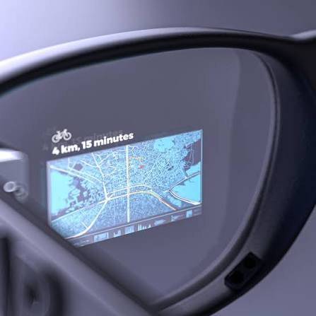

What We Make at [Company]
Our Products: [e.g., We design high-power lasers / optical sensors / precision lenses / quantum light chips]
Real-World Impact: Our technology helps [e.g., build smartphones / inspect solar panels / guide autonomous cars]
Cool Lab Gadget: [Describe a physical item brought to class, e.g., laser pointer diffraction, optical lens, or fiber demo]

Slide 10




From Creative Idea to Real Product
2. Lab Prototyping
4. Real-World Launch
Building prototypes using precision lasers, mirrors, and fiber lines.
Integrating photonics into rockets, cars, phones, and hospitals worldwide.
1. Design & Simulation
3. Cleanroom Testing
Engineers model light rays and optical lenses on 3D computer software.
Testing hardware in dust-free cleanrooms with specialized light meters.

Slide 11
Our Achievements
Highlight breakthrough products: [e.g. ultra-fast lasers, high-efficiency solar cells, advanced imaging systems].
Collaborations with leading research institutions and industries.

Slide 12
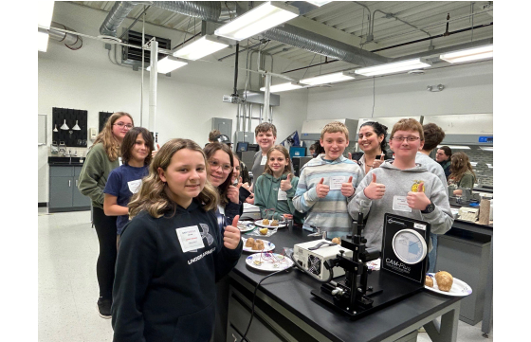
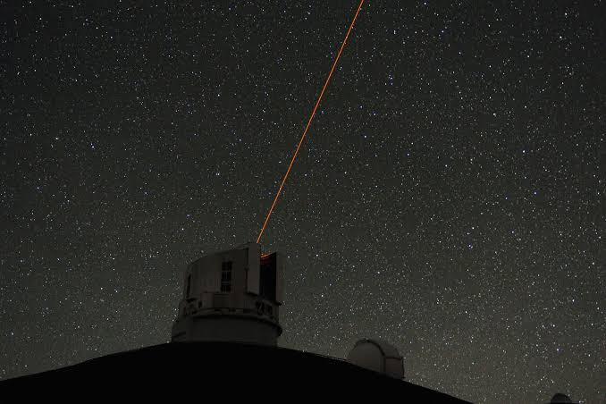

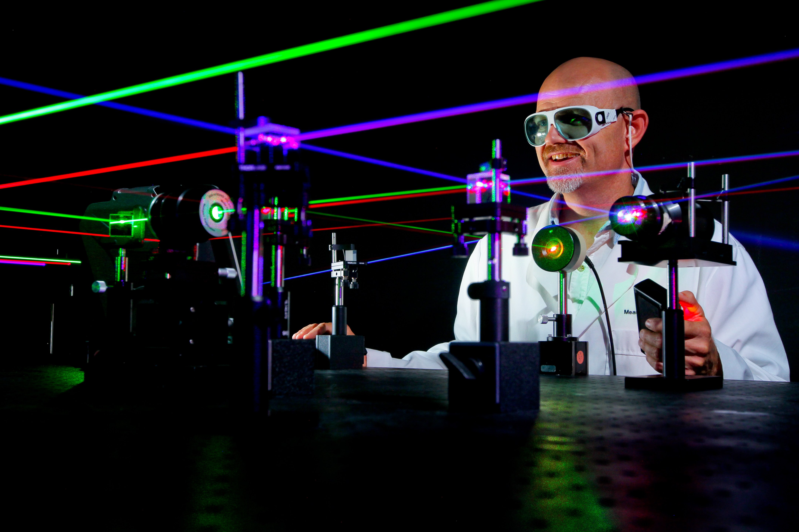
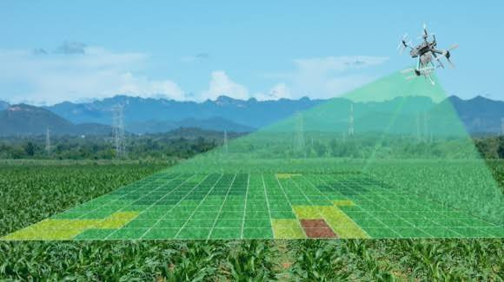
Why Build a Future in Photonics?
⚡
High Demand Jobs: Tech companies around the globe are searching for engineers, designers, and scientists who understand light.
⚡
Solve Global Challenges: Help fight climate change (solar energy), protect oceans (light sensors), and cure diseases.
⚡
Play with Cool Toys: Work with high-tech lasers, holograms, VR gear, robotics and space technology every day!

Slide 13
Join Us in Shaping the Future
Opportunities for students: [describe internships, research partnerships, vacancies].
Contribute to the next wave of photonics innovation with [Company Name].

Slide 14
Questions & Discussion
What light-powered technology are you most excited to build in the future?
[YOUR COMPANY WEBSITE] • [CONTACT EMAIL / SOCIAL MEDIA]
Celebrating #DayOfPhotonics • Inspiring the Next Generation

